Slide 1

SAY HELLO TO
Liane Stevenson @webdevelopwolf www.webdevelopwolf.com

Slide 2
INTRODUCTION
Lets get on the road…

Slide 3

What did we do last time?
Why design our apps?
Stages of app design
Benefits of app design

Slide 4
What are we doing in this section?
What Ionic is and does
Build our first Ionic App
How navigation works
Skeleton App

Slide 5
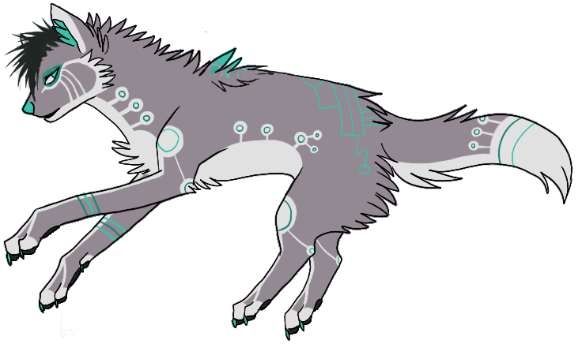
Need help?
Github:
http://www.github.com/webdevelopwolf/training
Twitter:
http://www.twitter.com/webdevelopwolf
Facebook:
http://www.facebook.com/webdevwolf
Discord:
https://discord.gg/jWGvtnZ

Slide 6
WHY IONIC?
It’s not electric, it’s supercharged!

Slide 7
What is Ionic?
“Ionic is an HTML5 mobile app development framework targeted at building hybrid mobile apps.”
From Ionic team’s documentation

Slide 8




Cool, but what’s a hybrid app?
Before Ionic, we had to build three apps in three languages (Objective C, PHP or C#).
Cordova creates a bridge between the three platforms using JavaScript, which creates our hybrid app.
So now we can make one application back-end, but we still need three different apps with three different looks.

Slide 9
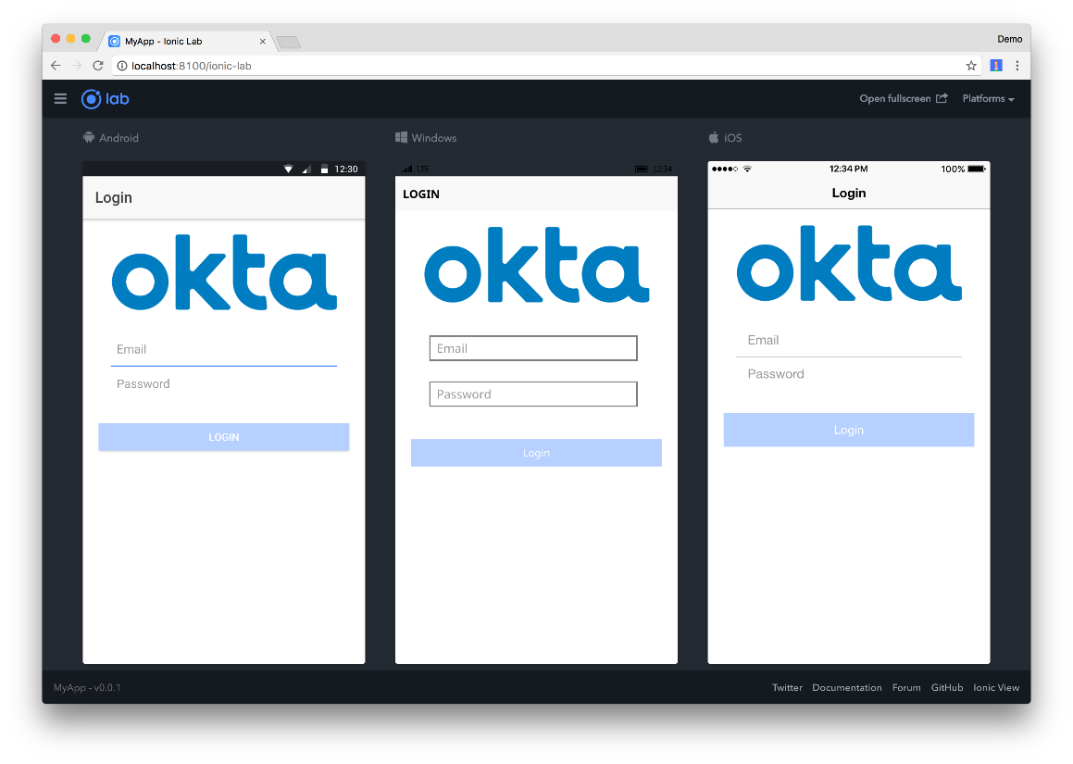
That’s where Ionic comes in…
Ionic detects the device it’s running on and styles accordingly.
Other Ionic benefits include:
Uses Angular and TypeScript
Powerful Navigation Stack
Intelligent Build System
Unrivalled Performance

